Slide 1

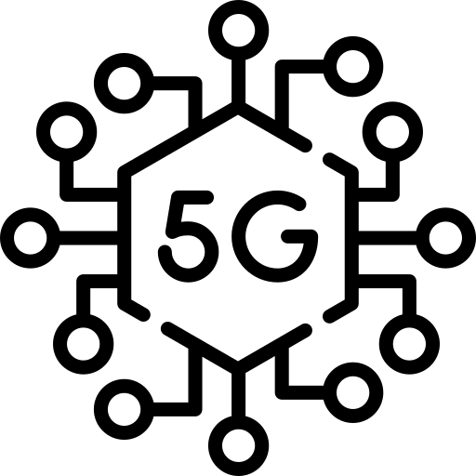





There are 4 challenges of 5G in Philippines because of the Philippines’ decision to allow Huawei equipment in its 5G networks.
Average 5G download speed of 140.6 (Mbps)
The Philippines’ decision to allow Huawei equipment in its 5G networks
1
Challenge of 5G in Philippines
5G in the Philippines and the global Huawei controversy
U.S.-Philippine military collaboration
Foreign direct investment and the Philippines’ digital economy
Domestic divisions and the 2022 presidential elections
3
5G in Philippines
2
A significantly faster average 5G download speed in every market
5G video experience score that is 34% higher than using 4G
Resource : https://www.asiapacific.ca/publication/5g-geopolitics-and-philippines-huawei-controversy

